Slide 1
Integrating security in DevOps do and don’ts
Victoria Almazova

Slide 2
Integrating security in DevOps do and don’ts Year later
Victoria Almazova

Slide 3
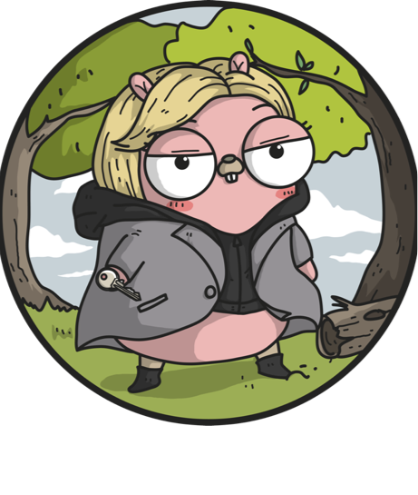
Victoria Almazova
Security girl in Microsoft
Always curious about what happens under the hood
@texnokot
https://github.com/texnokot

Slide 4


Slide 5


Slide 6

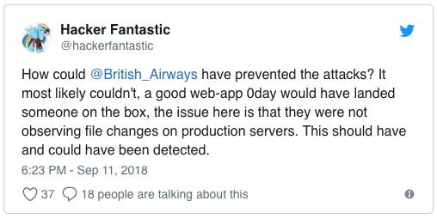
22 lines of code to steal British Airways’ customer data
Compromised 380 000 customers
77 000 addresses, emails, payment details
108 000 credit/debit cards CVV

Slide 7
22 lines of code of JavaSript in modernizr-2.6.2.min.js
https://www.riskiq.com/blog/labs/magecart-british-airways-breach/

Slide 8
Hacked by Magecart
https://www.riskiq.com/blog/labs/magecart-british-airways-breach/

Slide 9
Lessons learned

Slide 10
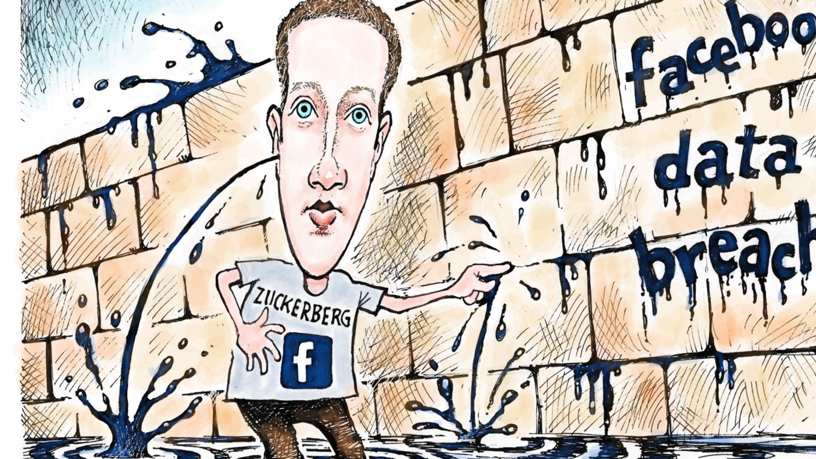
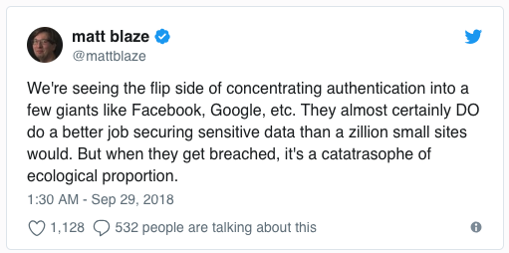
50 Million Facebook users were hacked

Slide 11
3 vulnerabilities in the “View As” functionality
A video uploader to show up in “View As”
Generated an access token for mobile app
New access token not for a user, but for “view as” person

Slide 12
Lessons learned

Slide 13
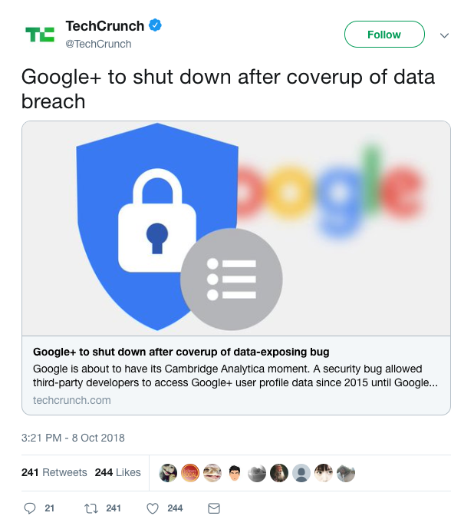
500,000 Google+ accounts may have been compromised

Slide 14
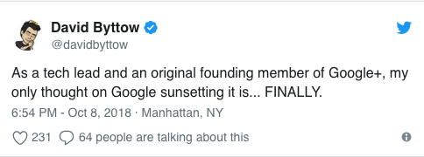

Slide 15
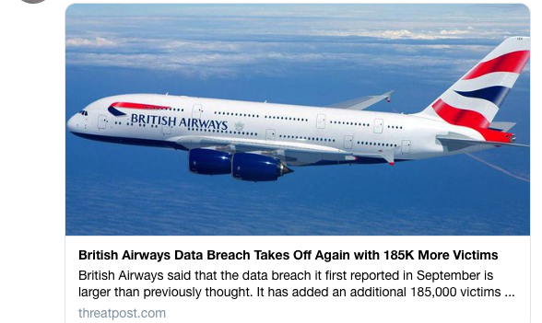
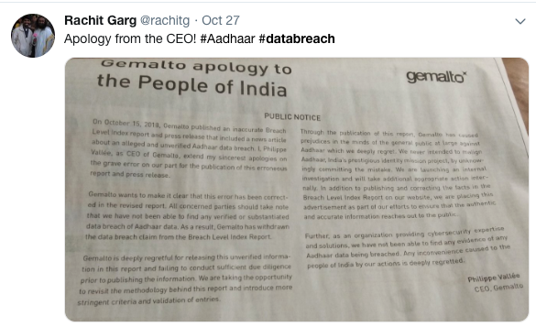
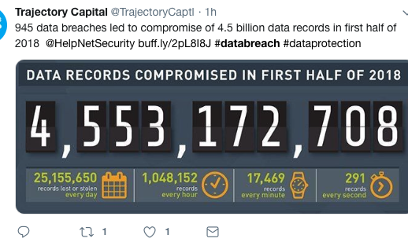
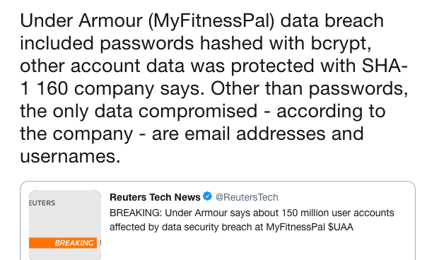

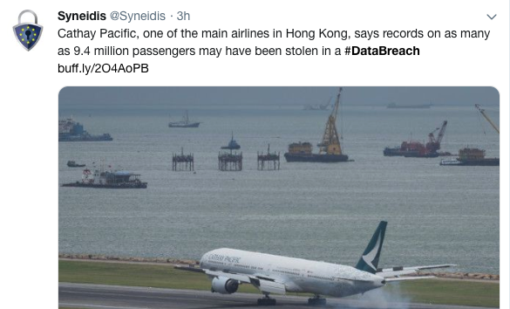
#databreach

Slide 16
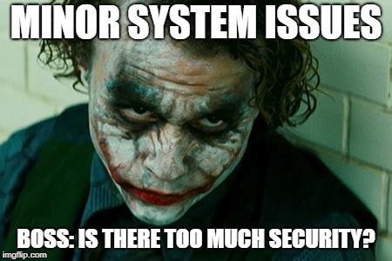

Slide 17
Embrace and enhance education

Slide 18
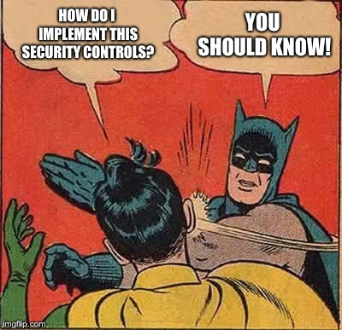

Slide 19
Build Security champions

Slide 20
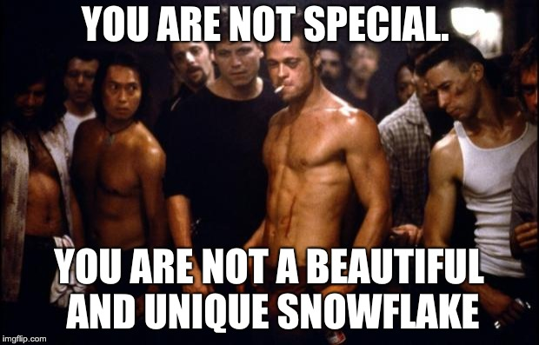
https://en.wikipedia.org/wiki/Generation_Snowflake

Slide 21
You control code You control security

Slide 22

Bringing security into the Pipeline

Slide 23
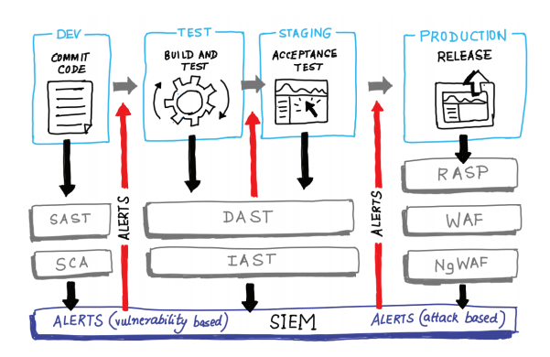
Image from book: «DevOpsSec» by Jim Bird

Slide 24



Develop and commit the code
Before you commit
Get rid of secrets from the code. Finally
Static analysis checking in the developer’s IDE
Threat Modeling
Peer code review

Slide 25



Develop and commit the code
Commit
Software component analysis in 3rd party components
Incremental static analysis scanning
Automated unit testing of security functions
Digitally signing binary artifacts

Slide 26
Staging
Acceptance stage
Secure and automate configuration management and provisioning
Smoke tests to catch mistakes in configuration or deployment
Dynamic application security testing
Automated security attacks
Fuzzing of APIs
Manual pen testing
Red teaming

Slide 27
Production
Going and staying alive
Cloud resources governance and provisioning
Runtime checks and monkeys
IAM hygiene
Security scanning
Alerting and monitoring
Bug Bounty program
Blameless postmortems

Slide 28
Make security as a culture

Slide 29
Thank you!
Victoria Almazova

